Slide 1
Machine Learning ZG565
Dr. Sugata Ghosal
Sugata.ghosal@pilani.bits-pilani.ac.in

Slide 2
Session 1
Date – 20th May 2023
Time – 2 PM to 4 PM
These slides are prepared by the instructor, with grateful acknowledgement of many others who made their course materials freely available online.

Slide 3
Session Content
Objective of course
Evaluation Plan
What is Machine Learning?
Application areas of Machine Learning
Why Machine Learning is important?
Design a Learning System
Issues in Machine Learning

Slide 4
Objective of course
Introduction to the basic concepts and techniques of Machine Learning
Gain experience of doing independent study and research in the field of Machine Learning
Develop skills of using recent machine learning software tools to evaluate learning algorithms and model selection for solving practical problems

Slide 5
What We’ll Cover in this Course
Supervised learning algorithms
Regression
Naïve Bayes
Logistic regression
Decision Tree and Random Forest
Support vector machines
Ensemble Techniques
Unsupervised learning
Clustering
Applications

Slide 6
Books
Text books and Reference book(s)
T1 | Tom M. Mitchell: Machine Learning, The McGraw-Hill Companies
R1 R2 R3 | Christopher M. Bishop: Pattern Recognition & Machine Learning, Springer P. Tan, et al. Introduction to Data Mining, Pearson C.J.C. BURGES: A Tutorial on Support Vector Machines for Pattern Recognition, Kluwer Academic Publishers, Boston.
Notes:
The requirements of information security within an organization have undergone two major changes in the last several decades. Before the widespread use of data processing equipment,the security of information felt to be valuable to an organization was provided primarily by physical (eg. rugged filing cabinets with locks) and administrative mechanisms (eg. Personnel screening procedures during hiring process).
Growing computer use implies a need for automated tools for protecting files and other information stored on it. This is especially the case for a shared system, such as a time-sharing system, and even more so for systems that can be accessed over a public telephone network, data network, or the Internet.
The second major change that affected security is the introduction of distributed systems and the use of networks and communications facilities for carrying data between terminal user and computer and between computer and computer. Network security measures are needed to protect data during their transmission.

Slide 7
Evaluation Plan
Name | Type | Weight
3 Quiz, best 2 scores will be taken | Online | 10%
Assignment-I | Take Home | 10%
Assignment-II | Take Home | 10%
Mid-Semester Test | Closed Book | 30%
Comprehensive Exam | Open Book | 40%
Please note there will be no change in submission dates for quiz and assignment

Slide 8
Lab Plan
Lab No. | Lab Objective
1 | End to End Machine Learning
2 | Linear Regression and Gradient Descent Algorithm
3 | Logistic Regression Classifier
4 | Decision Tree
5 | Naïve Bayes Classifier
6 | Random Forest
Labs not graded
Most of the Lab recordings available at CSIS virtual labs
Webinars will be conducted for lab sessions
Labs will be conducted in Python

Slide 9
Machine Learning
Machine learning is a scientific discipline that explores the construction and study of algorithms that can learn from data.
Such algorithms operate by building a model based on inputs and using that to make predictions or decisions, rather than following only explicitly programmed instructions.

Slide 10
A Few Quotes
“A breakthrough in machine learning would be worth ten Microsofts” (Bill Gates, Chairman, Microsoft)
“Machine learning is the next Internet” (Tony Tether, Director, DARPA)
“Web rankings today are mostly a matter of machine learning” (Prabhakar Raghavan, Dir. Research, Yahoo)
“Machine learning is going to result in a real revolution” (Greg Papadopoulos, CTO, Sun)
“Machine learning is today’s discontinuity” (Jerry Yang, CEO, Yahoo)

Slide 11
Traditional Programming
Computer
Data Program
Output
Machine Learning
Computer
Data Output
Program
Slide credit: Pedro Domingos

Slide 12
What is Machine Learning?
Definition by Tom Mitchell (1998):
"A computer program is said to learn from experience E with respect to some class of tasks T and performance measure P, if its performance at tasks in T, as measured by P, improves with experience E.” Example: playing checkers.
E = the experience of playing many games of checkers
T = the task of playing checkers.
P = the probability that the program will win the next game.

Slide 13
What is Machine Learning?
To have a learning problem, we must identify
The class of tasks
The measure of performance to be improved
Source of experience

Slide 14
Example of Learning Problems

Slide 15
A Checker Learning Problem
Task T: Playing Checkers
Performance Measure P: Percent of games won against opponents
Training Experience E: To be selected ==> Games Played against itself

Slide 16
A handwriting recognition learning problem
Task T: recognizing and classifying handwritten words within images
Performance measure P: percent of words correctly classified
Training Experience E: a database of handwritten words with given classifications

Slide 17
A robot driving learning problem
Task T: driving on public four-lane highways using vision sensors
Performance measure P: average distance travelled before an error (as judged by human)
Training experience E: a sequence of images and steering commands recorded while observing a human driver

Slide 18
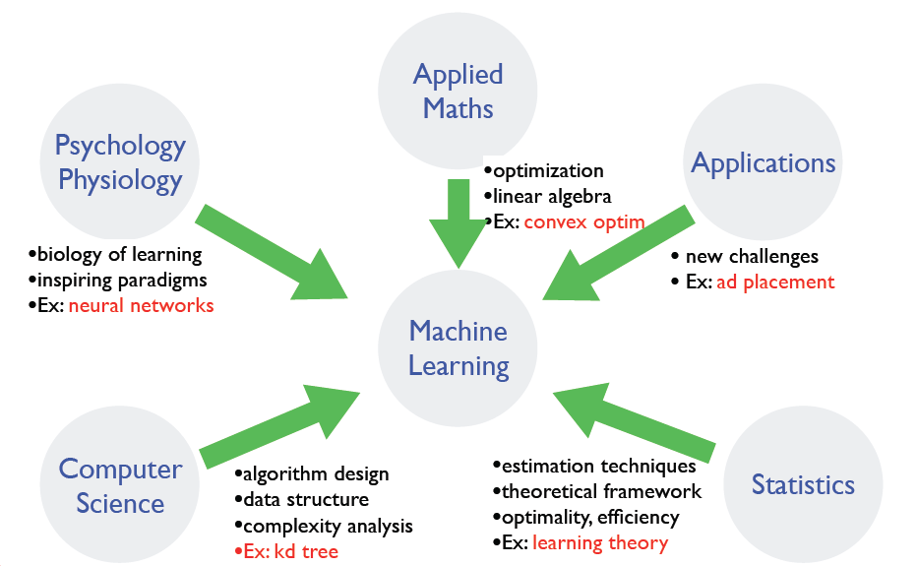
Where does ML fit in?
Slide credit: Dhruv Batra, Fei Sha

Slide 19
Why is Machine Learning Important?
Some tasks cannot be defined well, except by examples.
Relationships and correlations can be hidden within large amounts of data. Machine Learning may be able to find these relationships.
Human designers often produce machines that do not work as well as desired in the environments in which they are used.

Slide 20
Why is Machine Learning Important ?
The amount of knowledge available about certain tasks might be too large for explicit encoding by humans (e.g., medical diagnostic).
New knowledge about tasks is constantly being discovered by humans. It may be difficult to continuously re-design systems “by hand”.

Slide 21

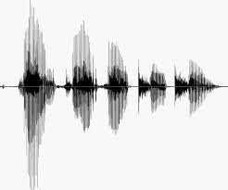
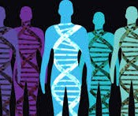
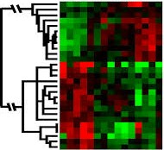
When Do We Use Machine Learning?
ML is used when:
Human expertise does not exist (navigating on Mars)
Humans can’t explain their expertise (speech recognition)
Models must be customized (personalized medicine)
Models are based on huge amounts of data (genomics)
Learning isn’t always useful:
There is no need to “learn” to calculate payroll
Slide Credit: Eric Eaton

Slide 22
Application Domains
Web search
Computational biology
Finance
E-commerce
Space exploration
Robotics
Information extraction
Social networks
Language Processing
Many more emerging…
Slide credit: Pedro Domingos

Slide 23
State of the Art Applications of Machine Learning
.

Slide 24
Application Types
Medical diagnosis
Credit card applications or transactions
Fraud detection in e-commerce
Worm detection in network packets
Spam filtering in email
Recommended articles in a newspaper
Recommended books, movies, music, or jokes
Financial investments
DNA sequences
Spoken words
Handwritten letters
Astronomical images
Slide credit: Ray Mooney

Slide 25
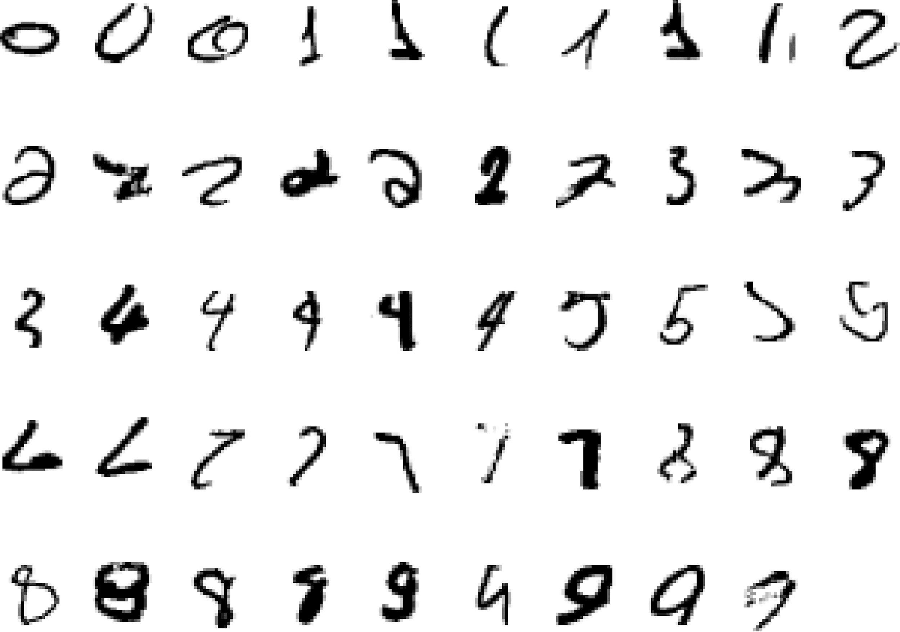
It is very hard to say what makes a 2
Pattern recognition
Slide credit: Geoffrey Hinton

Slide 26
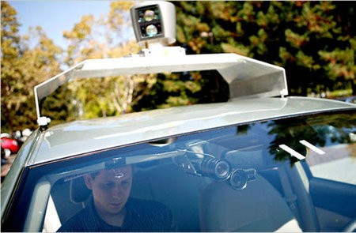
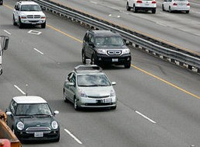
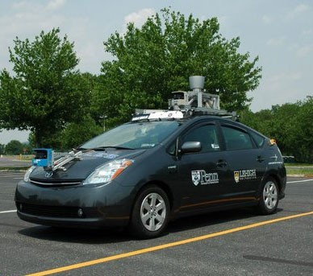
Autonomous Cars
Nevada made it legal for autonomous cars to drive on roads in June 2011
As of 2013, four states (Nevada, Florida, California, and Michigan) have legalized autonomous cars
UPenn’s Autonomous Car →
Slide credit: Eric Eaton

Slide 27
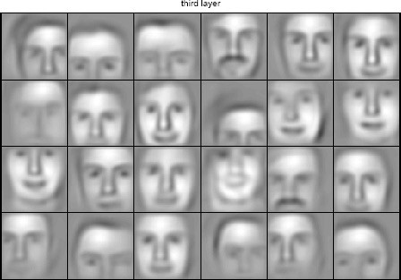
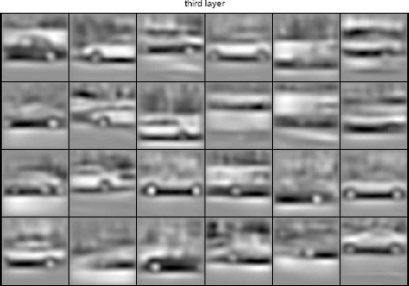
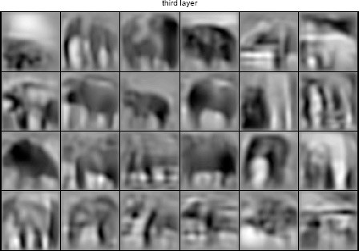
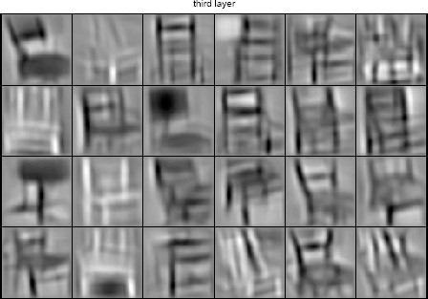
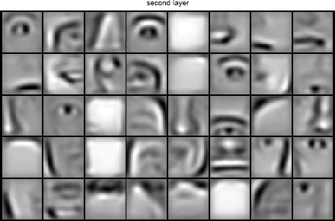
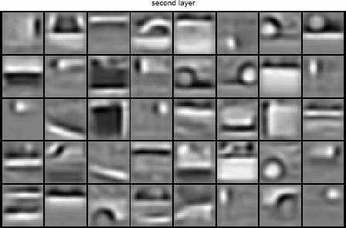
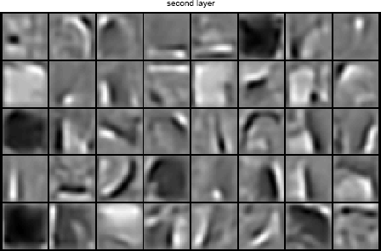
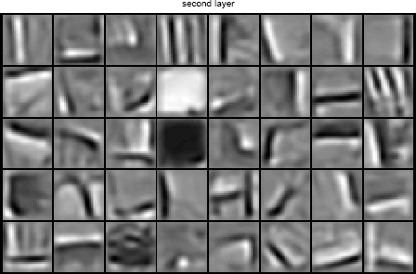
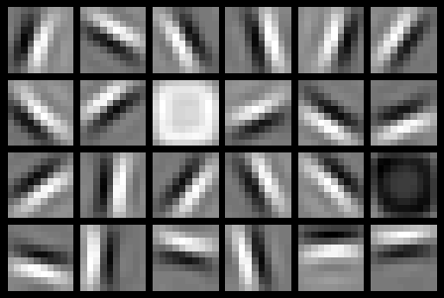
Learning of Object Parts
Slide credit: Andrew Ng

Slide 28
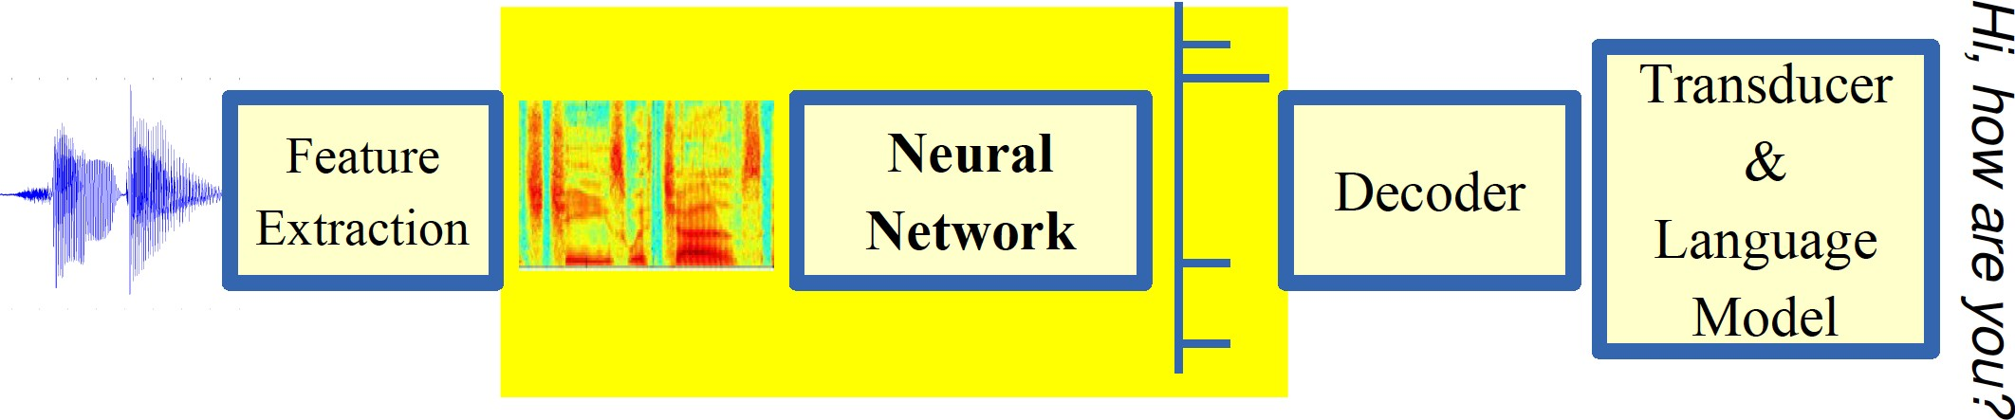
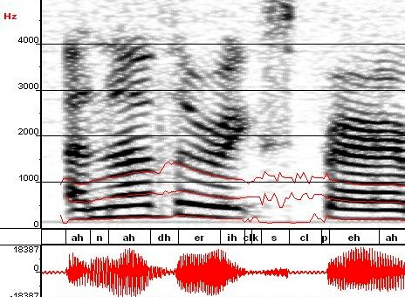
Automatic Speech Recognition
ML used to predict phoneme states from sound spectrogram Deep Learning Based Results
# Hidden Layers | 1 | 2 | 4 | 8 | 10 | 12
Word Error Rate % | 16.0 | 12.8 | 11.4 | 10.9 | 11.0 | 11.1
Baseline Gaussian Mixture Model based word error rate = 15.4%
[Zeiler et al. “On rectified linear units for speech recognition” ICASSP 2013]
Slide credit: Eric Eaton

Slide 29
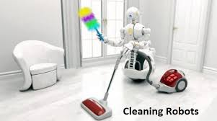
Robotics

Slide 30
Types of Learning
Supervised (inductive) learning
Given: training data, desired outputs (labels)
Unsupervised learning
Given: training data (without desired outputs)
Semi-supervised learning
Given: training data + a few desired outputs
Reinforcement learning
Given: rewards from sequence of actions
Slide Credit: Eric Eaton

Slide 31




Supervised Learning: Regression
Given (x₁, y₁), (x₂, y₂), ..., (x_{n}, y_{n})
Learn a function f(x) to predict y given x
9
8
7
6
5
4
3
2
1
0
1970 1980
September Arctic Sea Ice Extent (1,000,000 sq km)
1990
Year
2000
2010
2020
Data from G. Witt. Journal of Statistics Education, Volume 21, Number 1 (2013) Slide Credit: Eric Eaton

Slide 32
Regression
y = f(x)
Training: given a training set of labeled examples {(x₁,y₁), …, (x_{N},y_{N})}, estimate the prediction function f by minimizing the prediction error on the training set
Testing: apply f to a never before seen test example x and output the predicted value y = f(x)
output
prediction function
features
Slide credit: L. Lazebnik

Slide 33
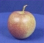
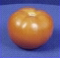
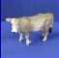
Classification Example
Apply a prediction function to a feature representation of the image to get the desired output:
f( ) = “apple”
f( ) = “tomato”
f( ) = “cow”
Slide credit: L. Lazebnik

Slide 34


















Supervised Learning: Classification
Given (x₁, y₁), (x₂, y₂), ..., (x_{n}, y_{n})
Learn a function f(x) to predict y given x
– y is categorical == classification
Breast Cancer (Malignant / Benign)
1(Malignant)
0(Benign)
Tumor Size
^{Predict Benign} Predict Malignant
Tumor Size
Slide Credit: Eric Eaton

Slide 35

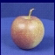
Classification
Training
Training Labels
Training Images
Features
Training
Learned model
Testing
Features
Learned model
Prediction
Test Image
Slide credit: D. Hoiem and L. Lazebnik

Slide 36















Unsupervised Learning
Given x₁, x₂, ..., x_{n} (without labels)
Output hidden structure behind the x’s
– E.g., clustering
Slide Credit: Eric Eaton

Slide 37

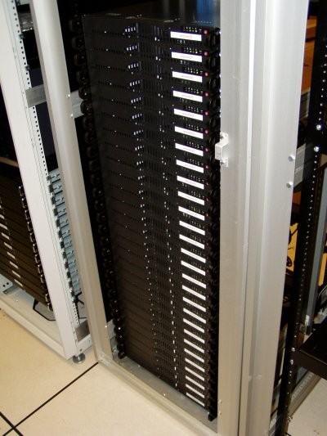
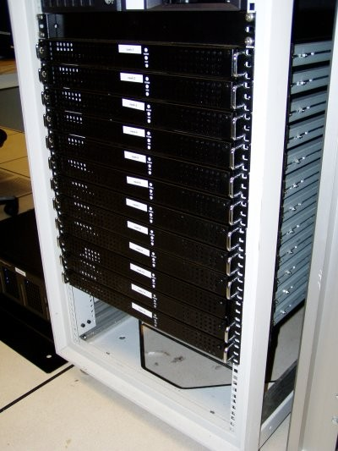



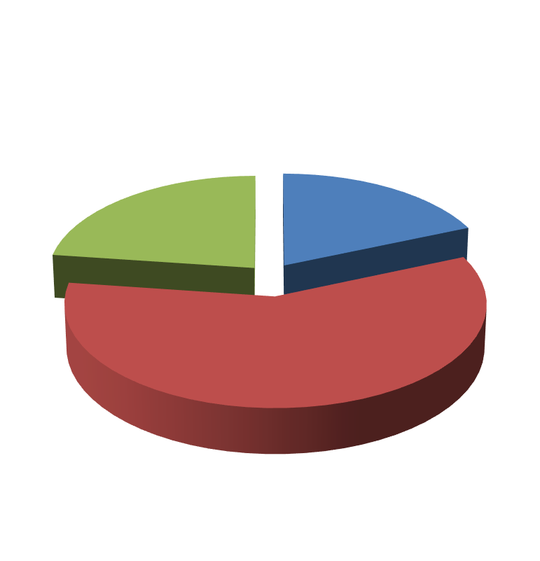

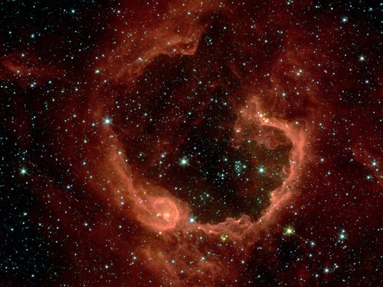


Unsupervised Learning
Organize computing clusters
Social network analysis
Market segmentation
Slide credit: Andrew Ng
Image credit: NASA/JPL-Caltech/E. Churchwell (Univ. of Wisconsin, Madison)
Astronomical data analysis

Slide 38
Reinforcement Learning
No predefined data
Semi-supervised learning model in machine learning,
Allow an agent to take actions and interact with an environment so as to maximize the total rewards.
Examples:
Resources management in computer clusters
Game playing
Robot in a maze
Slide Credit: Eric Eaton
Notes:
Reinforcement vs. Unsupervised Learning: Reinforcement Learning basically has a mapping structure that guides the machine from input to output. However, Unsupervised Learning has no such features present in it. In Unsupervised Learning, the machine focuses on the underlying task of locating the patterns rather than the mapping for progressing towards the end goal. For example, if the task for the machine is to suggest a good news update to a user, a Reinforcement Learning algorithm will look to get regular feedback from the user in question, and would then through the feedback build a reputable knowledge graph of all news related articles that the person may like. On the contrary, an Unsupervised Learning algorithm will try looking at many other articles that the person has read, similar to this one, and suggest something that matches the user’s preferences.

Slide 39
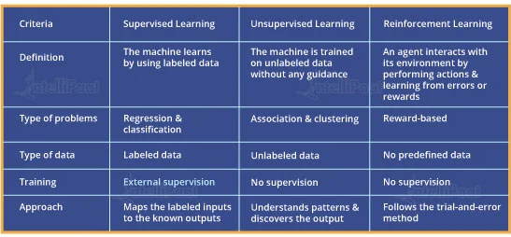
Supervised, Unsupervised and Reinforcement Learning Comparison

Slide 40
Open source ML programming tools
 | Platform |  | Algorithms or Features
Scikit Learn | Linux, Mac OS, Windows | Python, C, C++ | Classification, Regression, Clustering Preprocessing, Model Selection Dimensionality reduction.
PyTorch | Linux, Mac OS, Windows | Python, C++ | Autograd Module, Optimization Module NN Module
TensorFlow | Linux, Mac OS, Windows | Python, C++ | Provides a library for dataflow programming.
Weka | Linux, Mac OS, Windows | Java | Data preparation, Classification Regression, Clustering, Visualization Association rules mining

Slide 41
Open source ML programming tools
Colab | Cloud Service | - | Supports libraries of PyTorch, Keras, TensorFlow, and OpenCV
Apache Mahout | Cross-platform | Java Scala | Preprocessors,Regression Clustering, Recommenders Distributed Linear Algebra.
Accors.Net | Cross-platform | C# | Classification, Regression, Distribution Clustering, Hypothesis Tests & Kernel Methods, Image, Audio & Signal & Vision
Shogun | Windows Linux, UNIX Mac OS | C++ | Regression, Classification, Clustering Support vector machines. Dimensionality reduction, Online learning etc.
Keras.io | Cross-platform | Python | API for neural networks

Slide 42


Slide 43
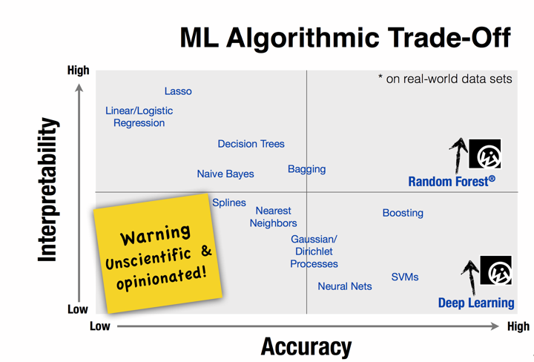

Slide 44
Design a Learning System

Slide 45






Designing a Learning System
Choose the training experience(data)
Choose exactly what is to be learned
– i.e. the target function
Choose how to represent the target function
Choose a learning algorithm to infer the target function from the experience
Training data
Learner
Environment/ Experience
Knowledge
Testing data
Performance Element
Slide Credit: Ray Mooney

Slide 46
Designing a Learning System: An Example
1. Problem Description (Ex: Playing checkers)
2. Choosing the Training Experience (data expressed as features)
3. Choosing the Target Function to be learnt (Ex: deciding next board position
4. Choosing a Representation for the Target Function (design a function as linear etc)
5. Choosing a Function Approximation Algorithm (parameters learning using loss function)
6. Final Design

Slide 47
Designing a Learning System: An Example
1. Problem Description (Ex: Playing checkers)
2. Choosing the Training Experience (data expressed as features)
3. Choosing the Target Function to be learnt (Ex: deciding next board position
4. Choosing a Representation for the Target Function (design a function as linear etc)
5. Choosing a Function Approximation Algorithm (parameters learning using loss function)
6. Final Design

Slide 48
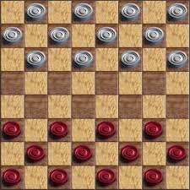
Choosing the training experience
In learning to play checkers, the system might learn from direct training examples consisting of individual checkers board states and the correct move for each.
Alternatively, it might have available only indirect information consisting of the move sequences and final outcomes of various games played.

Slide 49
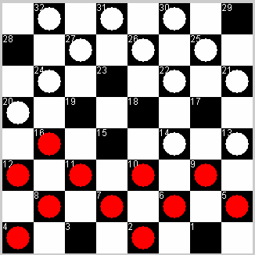
1) Choose the training experience
Direct
16 → 19

Slide 50
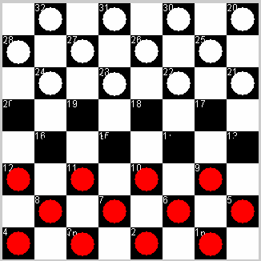
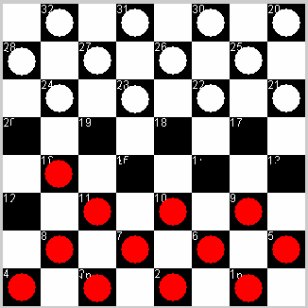
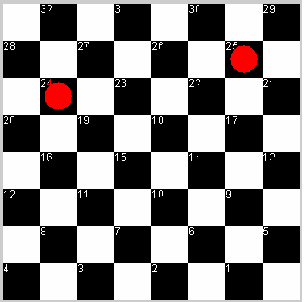
1) Choose the training experience
Indirect
WIN
Credit Assignment Problem!

Slide 51

1) Choose the training experience
•
Self-play experiments
•
No need for trainer.

Slide 52
2) Choose the target function
•
ChooseMove(B) → M
ChooseMove
= 16 → 19
Difficult, given our training experience

Slide 53
2) Choose the target function
•
V(b) → R
– Where V is an evaluation function that maps board, b, to some real number R.
V
= 30 points
Easier to learn

Slide 54
2) Choose the target function
12 → 16, or
For all legal moves:
=
11 →15, or
LegalMoves
….
- simulate that move
SimulateMove
12->16 =
- check the value of the result
V
= 30 points
Pick the best move

Slide 55
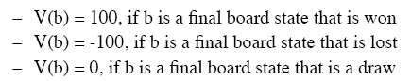
2) Choose the target function
•
What values should the target function, V, produce?
…but what about boards in the middle of a game?

Slide 56
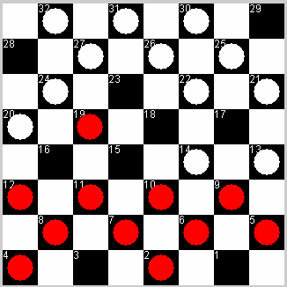
2) Choose the target function
….
b ‘
b
successor( b )
….
V(b’)=100
….
Not efficiently computable!

Slide 57
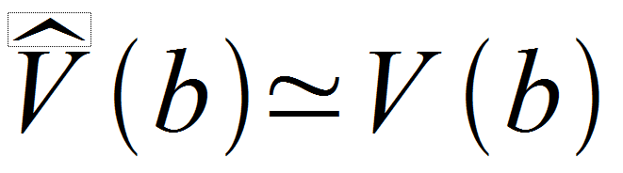
2) Choose the target function
•
•
V is too hard to learn
Function approximation
– Learn an approximation to ideal target function
V

Slide 58
3) Choose a representation
1) big table?
input: board
score
 | 50
 | 90
….

Slide 59
3) Choose a representation
2) CLIPS rules?
IF my piece is near a side edge THEN score = 80
IF my piece is near the opponents edge THEN score = 90
….

Slide 60
3) Choose a representation
3) polynomial function? we define some variables…
X₁ = number of white pieces on board X₂ = number of red pieces
X₃ = number of white kings X₄ = number of red kings
X₅ = number of white pieces threatened by red (can be captured on red’s next turn)
X₆ = number of red pieces threatened by white
e.g.
X₁ = 12
X₂ = 11
X₃ = 0
X₄ = 0
X₅ = 1
X₆ = 0

Slide 61
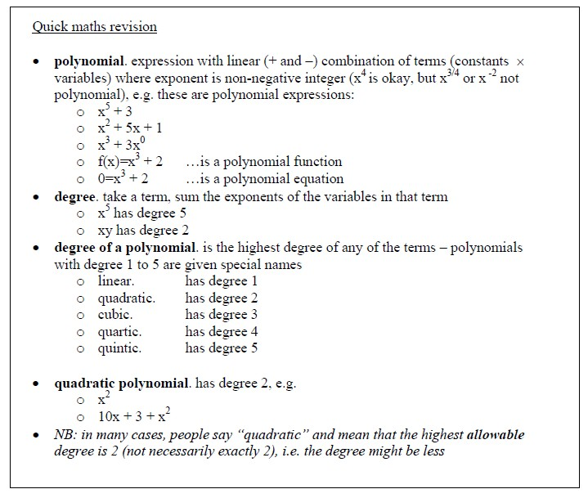
3) Choose a representation

Slide 62
3) Choose a representation
- Weighted linear combination:
Computer program will change the values of the weights – it will learn what the weights should be to give correct score for each board

Slide 63
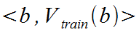
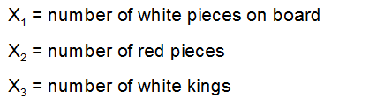
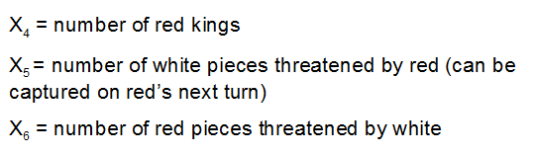
4) Choose a function approximation algorithm
•
•
•
Require a set of training examples Ordered pair:
e.g.
– Black has won (red has no pieces left):

Slide 64
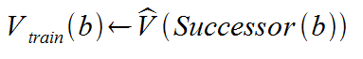
4) Choose a function approximation algorithm
•
What about intermediate board states?
Where Successor(b) is the next board state following b, which it is again the program's turn to move (i.e. the board state following the program's move and the opponents response)

Slide 65
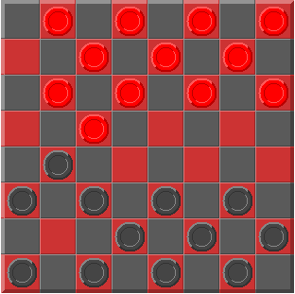
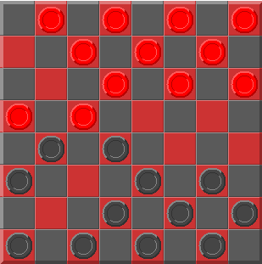
4) Choose a function approximation algorithm
•
b:
•
Successor(b):

Slide 66
4) Choose a function approximation algorithm
•
•
Now, we have the training data
Need an algorithm to adjust the weights to
best fit this training data.
Common approach: best set of weights will minimise the squared error, E, between training values and value predicted by
•

Slide 67
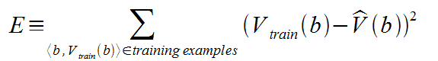
4) Choose a function approximation algorithm
- We wish to minimise E, for the observed training examples

Slide 68
4) Choose a function approximation algorithm
•
Need algorithm that will incrementally refine weights as more training examples become available
Needs to be robust to errors in training data
LMS training rule: will adjust weights a small amount in the direction that reduces the error
•
•

Slide 69
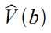
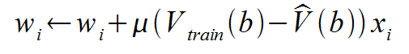
4) Choose a function approximation algorithm
•
LMS weight update rule.
– For each training example <b, V_{train}(b)>
•
•
Use the current weights to calculate
For each weight w_{i}, update it as
where,

Slide 70
4) Choose a function approximation algorithm
error
weight to update
learning rate
modify weight in proportion to size of attribute value

Slide 71
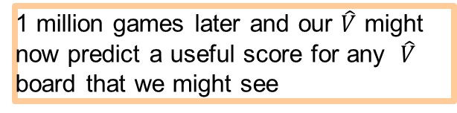
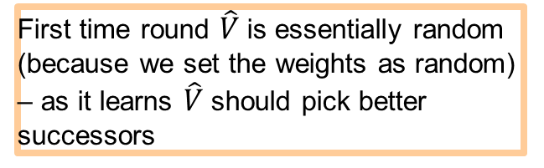
Final Algorithm
learning process – playing and learning at same time computer will play against itself
initialise with random weights (w = 23 etc.)
0
start a new game - for each board
calculate on all possible legal moves
pick the successor with the highest score
evaluate error
modify each weight to correct error
First time round $\hat{V}$is essentially random (because we set the weights as random) – as it learns $\hat{V}$should pick better successors
1 million games later and our $\hat{V}$ might now predict a useful score for any $\hat{V}$ board that we might see

Slide 72
Final Algorithm
(w₀ | = 25.0, w₁ | = 15.5, w₂ = 19.3, ..., w₆ = 54.4)
(w₀ | = 82.0, w₁ | = 15.3, w₂ = 9.9, ..., w₆ = 100.0)
(w₀ … | = 67.3, w₁ | = 0.5, w₂ = 3.5, ..., w₆ = 30.2)
(w₀ | = 3.23, w₁ | = 1.04, w₂ = 4.55, ..., w₆ = 0.78)
•
Searching hypothesis space for best fit to observed training data.

Slide 73


Slide 74


Slide 75


Slide 76
Final Design for Checkers Learning
The Performance Module (performance) : Takes as input a new board and outputs a trace of the game it played against itself.
The Critic (data generation) : Takes as input the trace of a game and outputs a set of training examples of the target function
The Generalizer (learner): Takes as input training examples and outputs a hypothesis which estimates the target function.
The Experiment Generator (task): Takes as input the current hypothesis (currently learned function) and outputs a new problem (an initial board state) for the performance system to explore

Slide 77
ML in a Nutshell
Tens of thousands of machine learning algorithms
Hundreds new every year
Every ML algorithm has three components
Representation
Optimization
Evaluation
Slide credit: Pedro Domingos

Slide 78
Evaluation
Accuracy
Precision and recall
Squared error
Likelihood
Posterior probability
Cost / Utility
Margin
Entropy
etc.
Slide credit: Pedro Domingos

Slide 79
Evaluating Performance
If y is discrete:
Accuracy: # correctly classified / # all test examples
Precision/recall
True Positive, False Positive, True Negative, False Negative
Precision = TP / (TP + FP) = # predicted true pos / # predicted pos
Recall = TP / (TP + FN) = # predicted true pos / # true pos
F-measure
= 2PR / (P + R)
Want evaluation metric to be in some range, e.g. [0 1]
0 = worst possible classifier, 1 = best possible classifier
Notes:
Diagnosis example

Slide 80

Evaluating Performance
If y is continuous:
Sum-of-Squared-Differences (SSD) error between predicted and true y:

Slide 81
Issues in Machine Learning
What algorithms are available for learning a concept? How well do they perform?
How much training data is sufficient to learn a concept with high confidence?
When is it useful to use prior knowledge?
Are some training examples more useful than others?
What are the best tasks for a system to learn?
What is the best way for a system to represent its knowledge?

Slide 82
Training vs Testing
What do we want?
High accuracy on training data?
No, high accuracy on unseen/new/test data!
Why is this tricky?
Training data
Features (x) and labels (y) used to learn mapping f
Test data
Features used to make a prediction
Labels only used to see how well we’ve learned f!!!
Validation data
Held-out set of the training data
Can use both features and labels to tune parameters of the model we’re learning
Slide Credit: Adriana Kovashka

Slide 83
Training vs. Test Distribution
We generally assume that training and test examples are independently drawn from the same overall distribution of data
– We call this “i.i.d” which stands for “independent and identically distributed”
Slide credit: Ray Mooney

Slide 84


ML in Practice
Understand domain, prior knowledge, and goals
Data integration, selection, cleaning, pre-processing, etc.
Learn models
Interpret results
Consolidate and deploy discovered knowledge
Loop
Based on a slide by Pedro Domingos

Slide 85
Recommended Readings
Tom M. Mitchell, Machine Learning, The McGraw-Hill Companies, Inc. International Edition 1997. [Ch. 1]
http://www.cs.princeton.edu/courses/archive/spr08/cos511/ [Web]
https://www.softwaretestinghelp.com/machine-learning-tools/

Slide 86
END of Session 1

